Slide 1
First Order Logic (FOL)/ Predicate Logic
By
Mrs Vishakha Shelke
Assistant Professor,
CSE(IOT and CyberSecurity with Blockchain technology)Department
DJSCE

Slide 2
Content
Why FOL
Syntax of FOL
Symbols and Interpretation
Inference in FOL

Slide 3
Why Predicate Logic ?
The propositional logic is not powerful enough to represent all types of assertions that are used in computer science.
For example, the assertion "x is greater than 1", where x is a variable, is not a proposition because you can not tell whether it is true or false unless you know the value of x.
"Not all birds fly" is equivalent to "Some birds don't fly".
"Not all integers are even" is equivalent to "Some integers are not even".

Slide 4
First order Predicate Logic
Predicate Logic (also called predicate calculus) is more expressive than propositional logic because it can represent objects, properties of objects, and relationships between objects.

Slide 5
First-order logic
First-order logic (FOL) models the world in terms of
  Objects, which are things with individual identities
  Examples : Students, lectures, companies, cars ...
  Properties of objects that distinguish them from other objects
  Examples: blue, oval, even, large, ...
  Relations that hold among sets of objects
  Examples: Brother-of, bigger-than, outside, part-of, has-color, occurs-after, owns, visits, precedes, ...
  Functions, which are a subset of relations where there is only one “value” for any given “input”
  father-of, best-friend, second-half, one-more-than ...

Slide 6
Predicate and Quantifiers
To cope with deficiencies of propositional logic we introduce two new features: predicates and quantifiers.
A predicate is a verb phrase template that describes a property of objects, or a relationship among objects represented by the variables.
"The car John is driving is blue", "The sky is blue", and "The cover of this book is blue"
"B(x)", where x represents an arbitrary object. B(x) reads as "x is blue".

Slide 7
User provides
Constant symbols, which represent individuals in the world
  Mary
  3
  Green
Function symbols, which map individuals to individuals
  father-of(Mary) = John
  color-of(Sky) = Blue
Predicate symbols, which map individuals to truth values
  greater(5,3)
  green(Grass)
  color(Grass, Green)

Slide 8
FOL Provides
Variable symbols
  E.g., x, y, foo
Connectives
  Same as in PL: not (¬), and (∧), or (∨), implies (→), if and only if (biconditional ↔)
Quantifiers
  Universal ∀x or (Ax)
  Existential ∃x or (Ex)

Slide 9
A BNF for FOL
S := <Sentence> ;
<Sentence> := <AtomicSentence> |
<Sentence> <Connective> <Sentence> |
<Quantifier> <Variable>,... <Sentence> |
"NOT" <Sentence> |
"(" <Sentence> ")";
<AtomicSentence> := <Predicate> "(" <Term>, ... ")" |
<Term> "=" <Term>;
<Term> := <Function> "(" <Term>, ... ")" |
<Constant> |
<Variable>;
<Connective> := "AND" | "OR" | "IMPLIES" | "EQUIVALENT";
<Quantifier> := "EXISTS" | "FORALL" ;
<Constant> := "A" | "X1" | "John" | ... ;
<Variable> := "a" | "x" | "s" | ... ;
<Predicate> := "Before" | "HasColor" | "Raining" | ... ;
<Function> := "Mother" | "LeftLegOf" | ... ;

Slide 10
Quantifiers
Universal quantification
  (∀x)P(x) means that P holds for all values of x in the domain associated with that variable
  E.g., (∀x) dolphin(x) → mammal(x)
“All students enjoy AI lectures”
  ∀ X (student(X) → enjoys(X,ai_lectures))
Existential quantification
  (∃ x)P(x) means that P holds for some value of x in the domain associated with that variable
  E.g., (∃ x) mammal(x) ∧ tail(x)
  Permits one to make a statement about some object without naming it

Slide 11
Quantifiers
Universal quantifiers are often used with “implies” to form “rules”:
  “All students are smart”
  (∀x) [student(x) → smart(x) ] - “All students are smart”
Existential quantifiers are usually used with “and” to specify a list of properties about an individual:
  “There is a student who is smart”
  (∃x) [student(x) ∧ smart(x)]

Slide 12
Quantifier Scope
Switching the order of universal quantifiers does not change the meaning:
  (∀x)(∀y)P(x,y) ↔ (∀y)(∀x) P(x,y)
Similarly, you can switch the order of existential quantifiers:
  (∃x)(∃y)P(x,y) ↔ (∃y)(∃x) P(x,y)
Switching the order of universals and existentials does change meaning:
  Everyone likes someone:
  (∀x)(∃y) likes(x,y)
  Someone is liked by everyone:
  (∃y)(∀x) likes(x,y)

Slide 13
Translating English to FOL
Every gardener likes the sun.
  ∀x gardener(x) → likes(x,Sun)
All purple mushrooms are poisonous.
  ∀x (mushroom(x) ∧ purple(x)) → poisonous(x)
No purple mushroom is poisonous.
  ¬∃x purple(x) ∧ mushroom(x) ∧ poisonous(x)
  ∀x (mushroom(x) ∧ purple(x)) → ¬poisonous(x)
Clinton is not tall.
  ¬tall(Clinton)

Slide 14

FOL - Syntax

Slide 15
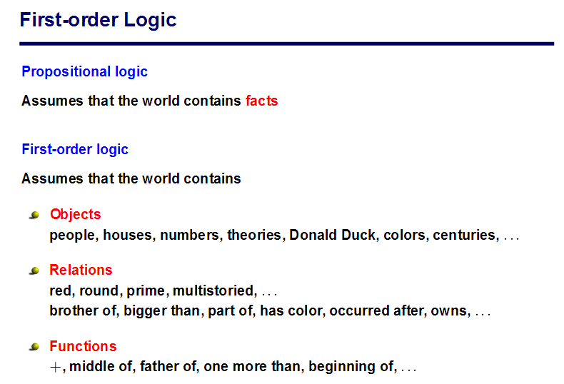

Slide 16
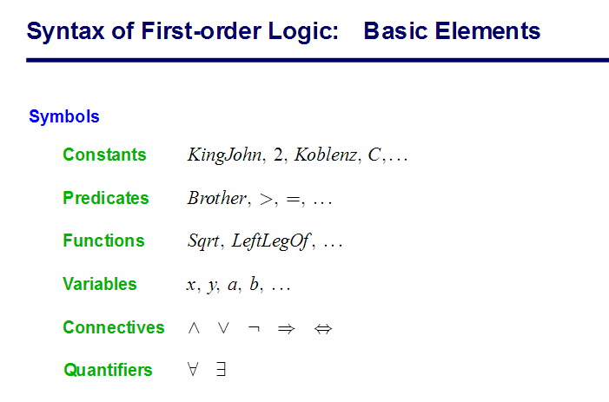

Slide 17
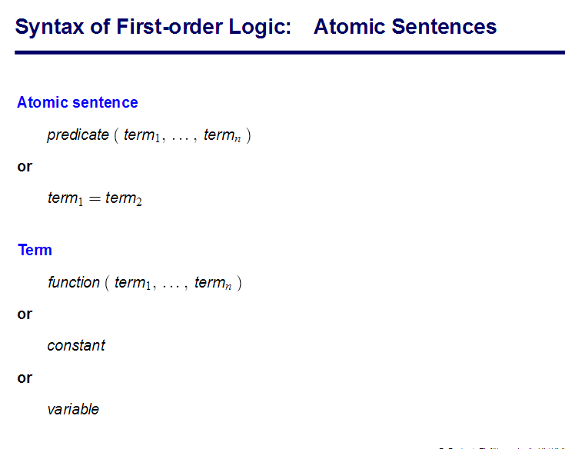

Slide 18
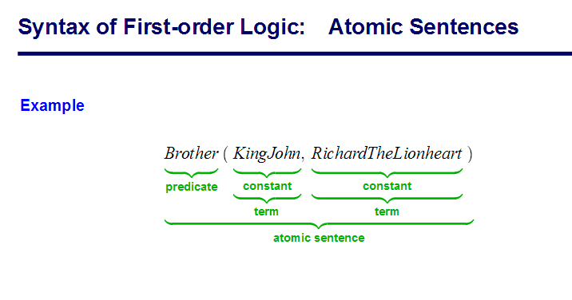

Slide 19
A BNF for FOL
S := <Sentence> ;
<Sentence> := <AtomicSentence> |
<Sentence> <Connective> <Sentence> |
<Quantifier> <Variable>,... <Sentence> |
"NOT" <Sentence> |
"(" <Sentence> ")";
<AtomicSentence> := <Predicate> "(" <Term>, ... ")" |
<Term> "=" <Term>;
<Term> := <Function> "(" <Term>, ... ")" |
<Constant> |
<Variable>;
<Connective> := "AND" | "OR" | "IMPLIES" | "EQUIVALENT";
<Quantifier> := "EXISTS" | "FORALL" ;
<Constant> := "A" | "X1" | "John" | ... ;
<Variable> := "a" | "x" | "s" | ... ;
<Predicate> := "Before" | "HasColor" | "Raining" | ... ;
<Function> := "Mother" | "LeftLegOf" | ... ;

Slide 20
Quantifiers
Universal quantification
  (∀x)P(x) means that P holds for all values of x in the domain associated with that variable
  E.g., (∀x) dolphin(x) → mammal(x)
“All students enjoy AI lectures”
  ∀ X (student(X) → enjoys(X,ai_lectures))
Existential quantification
  (∃ x)P(x) means that P holds for some value of x in the domain associated with that variable
  E.g., (∃ x) mammal(x) ∧ tail(x)
  Permits one to make a statement about some object without naming it

Slide 21
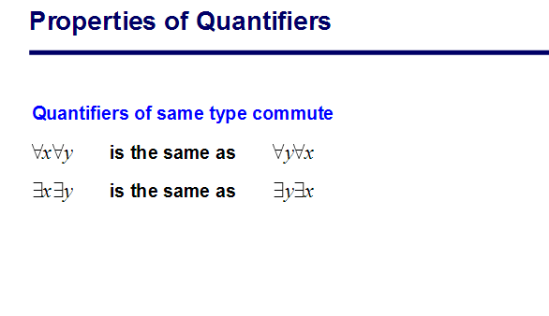

Slide 22
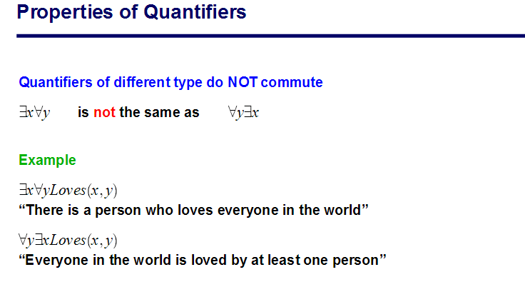
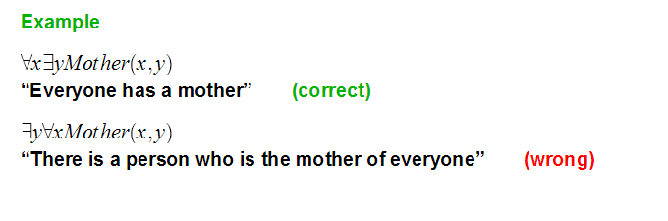

Slide 24
Connections between All and Exists
We can relate sentences involving ∀ and ∃ using De Morgan’s laws:
    (∀x) ¬P(x) ↔ ¬(∃x) P(x)
    ¬(∀x) P(X) ↔ (∃x) ¬P(x)
    (∀x) P(x) ↔ ¬ (∃x) ¬P(x)
    (∃x) P(x) ↔ ¬(∀x) ¬P(x)

Slide 25
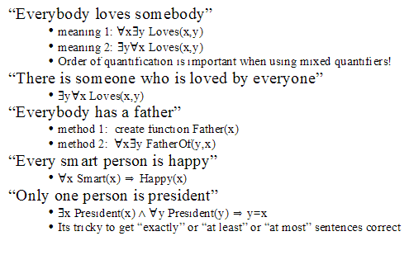
FOL –Examples

Slide 26
FOL -Exercise
Express the following sentences in first-order logic:
1. A friend of a friend is a friend. (Use a binary predicate Friend.)
2. An enemy’s enemy is a friend. (Use binary predicates Friend and Enemy.)
3. If two people are friends, then they are not enemies. (Use binary predicates
Friend and Enemy.)
4. Any two people are either enemies or friends. (Use binary predicates
Friend and Enemy.)
5. John has a friend. (Use a binary predicate Friend and constant J for
John.)
6. John has at least two friends. (Use a binary predicate F riend, constant
J for John, and equality=.)
7. John has exactly two friends, and everyone else is an enemy. (Use binary predicates Friend and Enemy, constant J for John, and equality=.)

Slide 27
FOL –Examples
1. A friend of a friend is a friend.
  ∀x∀y∀z(Friend(x, y) ∧ Friend(y, z) ⇒ Friend(x, z))
2. An enemy’s enemy is a friend.
  ∀x∀y∀z(Enemy(x, y) ∧ Enemy(y, z) ⇒ F riend(x, z))
3. If two people are friends, then they are not enemies.
  ∀x∀y(F riend(x, y) ⇒ ¬Enemy(x, y))
4. Any two people are either enemies or friends.
  ∀x∀y(F riend(x, y) ∨ Enemy(x, y))
5. John has a friend.
  ∃xF riend(J, x)
16. John has at least two friends.
  ∃x∃y(Friend(J, x) ∧ Friend(J, y) ∧ ¬(x = y))
7. John has exactly two friends, and everyone else is an enemy.
  ∃x∃y(Friend(J, x)∧Friend(J, y)∧¬(x = y)∧∀z(¬(z = x)∧¬(z = y) ⇒ Enemy(J, z))

Slide 28
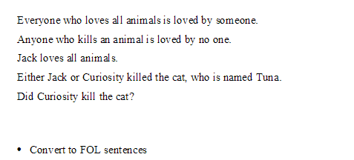
Convert to FOL

Slide 29
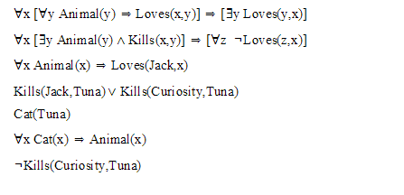
Example 2

Slide 30
Inference Rules for FOL

Slide 31
Inference Rules for FOL
Inference rules for PL apply to FOL as well. For example, Modus Ponens, And-Introduction, And-Elimination, etc.

Slide 32
Reasoning
Inference rules of predicate logic
  Universal instantiation
  Universal generalization
  Existential instantiation
  Existential generalization
  Negation of quantified statement
Inferenceing in predicate logic

Slide 33
Quantified inference rules
Universal instantiation
  ∀x P(x) ∴ P(A)
Universal generalization
  P(A) ∧ P(B) … ∴ ∀x P(x)
Existential instantiation
  ∃x P(x) ∴P(F)
Existential generalization
  P(A) ∴ ∃x P(x)

Slide 34
Universal Instantiation:
Rule
∀ x P(x)
-------
∴ P(c)
where c is some arbitrary element of the universe.

Slide 35
Universal Instantiation:
"No humans can fly. John is human. Therefore John can not fly."
First let us express this using the following notation:
F(x) means "x can fly."
H(x) means "x is human."
d=John.
Then the argument is
[∀ x [H(x)→~F(x)] ^ H(d) ] →~F(d).
The proof is (d= John)
1. ∀ x [H(x) →~ F(x)] Hypothesis
2. H(John) Hypothesis
3. H(John) →~ F(John) Universal instantiation on 1.
4. ~F(John) Modus ponens on 2 and 3.

Slide 36
Universal Generalization
Rule:
P(c)
----------
∴ ∀ x P(x)
where P(c) holds for every element c of the universe of discourse.

Slide 37
Universal Generalization
If P(c) holds for any arbitrary element c of the universe, then we can conclude that ∀ x P(x).
For every number x if x > 1, then x - 1 > 0. Also for every number x, x > 1.
Hence we conclude that for every number x, x - 1 >0.
This argument can be justified as follows using this Universal Generalization.

Slide 38
Example
For every number x if x > 1, then x - 1 > 0.
Also for every number x, x > 1.
Hence we conclude that for every number x, x - 1 >0.
Let P(x) represent x > 1, and Q(x) represent x - 1 > 0.
Then the argument above is represented by
[∀ x [P(x)→Q(x)] ^ ∀x P(x)] → ∀x Q(x).
To prove it we proceed as follows:
1 . ∀ x [P(x) → Q(x) ] Hypothesis
2. ∀ x P(x) Hypothesis
3. [P(x) → Q(x)] Universal Instantiation on 1.
4. P(x) for the same x as in 3 .Universal Instantiation on 2.
5. Q(x) Modus ponens on 3 and 4.
6. ∀ x Q(x) Universal Generalization on 6.

Slide 39
Existential Instantiation
(existential elimination)
From (∃x) P(x) infer P(c)
∃ x P(x)
-------
∴ P(c)
if P holds for some element of the universe, then we can give that element a name such as c (or x, y, a etc). When selecting symbols, one must select them one at a time and must not use a symbol that has already been selected within the same reasoning/proof.
Example:
  (∃x) eats(Ziggy, x) → eats(Ziggy, Stuff)
Note that the variable is replaced by a brand-new constant not occurring in this or any other sentence in the KB

Slide 40
Existential instantiation
If you get 75 on the final exam for AI, then you get an A for the course. John, gets 75 on the final exam.
Therefore John gets an A for AI.
F(X): x gets 75 on the final exam of AI
A(X) : x gets an A for AI.
Then the proof proceeds as follows:
1. ∀ x [ F(x) → A(x) ] Hypothesis
2. ∃ x F(x) Hypothesis
3. F(John) Existential instantiation on 3.
4. F(John)→A(John) Universal instantiation on 1.
5. A(John) Modus ponens on 3 and 4.

Slide 41
Existential Generalization/
(Existential introduction)
If P(c) is true, then (∃x) P(x) is inferred
P(c)
----------
∴ ∃x P(x)
If there is some element c in the universe that has the property P, then we can say that there exists something in the universe that has the property P.
Example
  Eats(John, IceCream) ⇒ (∃x) eats(John, x)
All instances of the given constant symbol are replaced by the new variable symbol
Note that the variable symbol cannot already exist anywhere in the expression

Slide 42
Negation of Quantified Statement
if P(x) : x is happy and the universe is the set of people.
Represent “There does not exist a person who is happy”
~ ∃x P(x)
Equivalent to “ Everyone is not happy”
∀ x ~P(x)
~ ∃x P(x) ↔ ∀ x ~P(x)

Slide 43
Example-
A check is void if it has not been cashed for 30 days. This check has not been cashed for 30 days. Therefore this check is void.
You can not cash a check which is void. Therefore you can not cash this check.
We now have a check which can not be cashed.
C(x): x is a check.
T(x): x has been cashed within 30 days.
V(x): x is void.
S(x): x can be cashed.
SBI1001 represents a specific object in the universe which corresponds to "this check".

Slide 44
1. A check is void if it has not been cashed for 30 days.
2.This check has not been cashed for 30 days.
3.Therefore this check is void.
4.You can not cash a check which is void.
5.Therefore you can not cash this check.
6.. We now have a check which can not be cashed.
C (x): x is a check.
T (x): x has been cashed within 30 days.
V (x): x is void.
S (x): x can be cashed.
SBI1001 represents a specific object in the universe which corresponds to "this check".
1. ∀ x [ [ C (x)^ ~T(x) ] → V(x) ]
2. ~T ( This_check )
-----------------------------------
3. V( This_check )
4. ∀ x [ [ C (x) ^ V (x) ] →~ S (x) ]
--------------------------------------
5. ~S ( This_check )
-----------------
6. ∃ x [ C (x) ^ ~S (x) ]

Slide 45
1. A check is void if it has not been cashed for 30 days. This check has not been cashed for 30 days. Therefore this check is void.
2.You can not cash a check which is void. Therefore you can not cash this check.
3. We now have a check which can not be cashed.
∀ x [ [ C (x)^ ~T(x) ] → V(x) ] by Universal Instantiation
  [ [ C (SBI1001)^ ~T (SBI1001) ] → V (SBI1001) ]
Since sib1001 is a check and T ( SBI1001 ) ,
[ C (SBI1001 ) ^ T ( SBI1001 ) ] holds.
Hence
[ [ C (SBI1001)^ ~T(SBI1001) ] → V(SBI1001) ]
[ C (SBI1001 ) ^ T ( SBI1001 ) ]
---------------------------------------------------------
V ( SBI1001) by Modus Ponens.
2. ∀ x [ [ C (x) ^ V (x) ] →~ S (x) ] - Universal Instantiation
[ [ C (SBI1001) ^ V (SBI1001) ] →~ S (SBI1001) ]
Since V (SBI1001 ) , and C ( SBI1001),
[ [ C (SBI1001) ^ V (SBI1001) ] →~ S (SBI1001) ]
[ C ( SBI1001 ) ^ V ( SBI1001 ) ]
----------------------------------------------------
~S ( SBI1001 ) by Modus Ponens.
Since C ( SBI1001 ) also holds,
~ S (SBI1001 )
C ( SBI1001)
----------------------------------------------------
C ( SBI1001 )^~ S ( SBI1001 )
Then by Existential Generalization ∃ x [ C ( x )^~S (x) ] .
C (x): x is a check.
T (x): x has been cashed within 30 days.
V (x): x is void.
S (x): x can be cashed.
SBI1001 represents a specific object in the universe which corresponds to "this check".

Slide 46
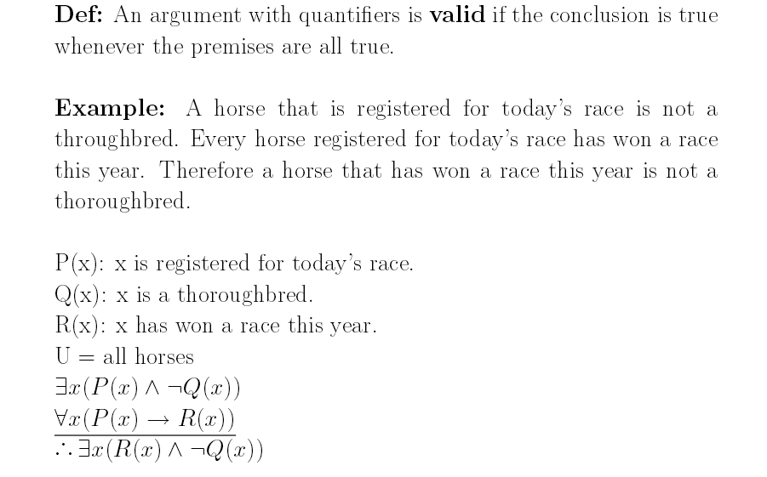

Slide 48
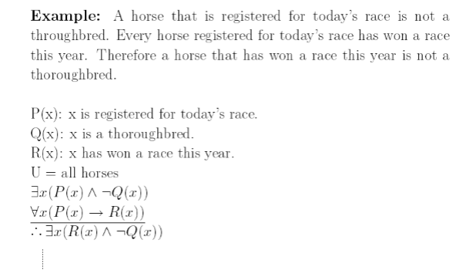
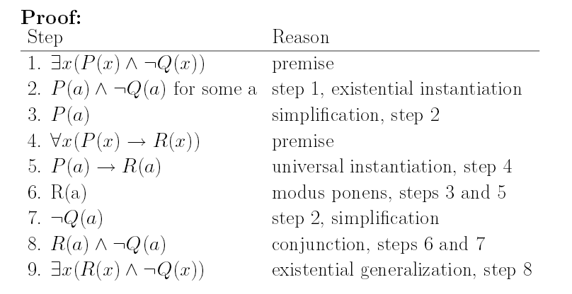

Slide 49
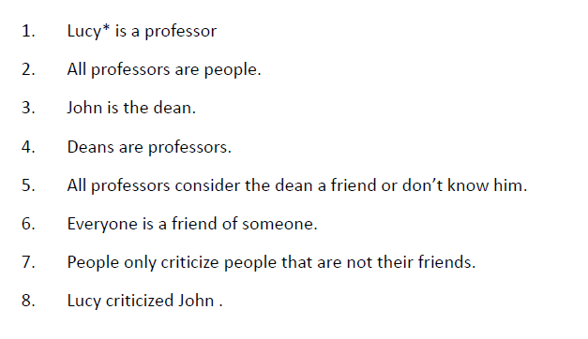
Exercise
Therefore Lucy is not friend of John

Slide 50
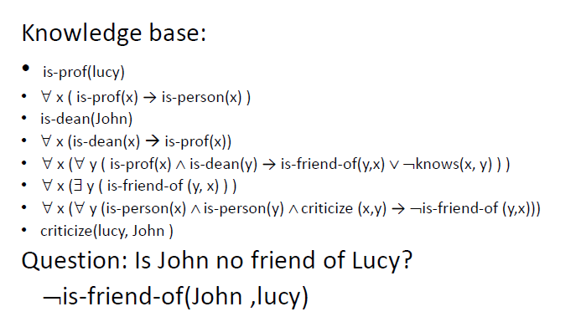
Prove that John is not friend of Lucky.

Slide 51
Prof(Lucy)
∀ x (Prof(x)→person(x))
Dean(John)
∀ x (dean(x)→Prof(x))
∀ x (∀ y ( Prof(x) ^ dean(y) →friend(y,x) V ~knows(x,y)))
∀ x (∃ y (friend(y,x)))
∀ x (∀ y (person(x) ^ person(y) ^
criticize (x,y)→ ~ friend(y,x)))
Critizie (lucy,john)

Slide 52
Prof(Lucy)
∀ x (Prof(x)→person(x))
Dean(John)
∀ x (dean(x)→Prof(x))
∀ x (∀ y ( Prof(x) ^ dean(y) →friend(y,x) V ~knows(x,y)))
∀ x (∃ y (friend(y,x)))
∀ x (∀ y (person(x) ^ person(y) ^ criticize (x,y)→ ~ friend(y,x)))
Critizie (lucy,john)
Prof(Lucy)→person(Lucy) universal instantiation of 2
Prof (lucy)
Person(lucy) ……………………………… Modus Ponens from 9,10
Dean(John)→ Prof (John) ……………..Universal Instantiation of 4
Prof(John) ………………………………… Modus Ponens 3, 12
Prof(Lucy) ^ dean(John) →friend(John,Lucy) V ~ Knows(Lucy,John) ….UI 5
Prof (John)→ Person(john)
Person (john) …………….Modus Ponenes 13, 15
Person(Lucy) ^ person(John)^ criticize (Lucy, John)→ ~ friend(john, Lucy) .. UI 7
~friend(john, Lucy) ……… 11,18,8 & 17 Modus Ponens

Slide 53
Exercises- propositional logic
IA) 1. If Alan did not lock the door he either forgot or lost the key.
2.f he lost the key he will be in trouble.
3. If he has a good memory he did not forget.
4. Alan has a good memory.
∴ Either Alan locked the door or he will be in trouble.
B) 1. Either the picture is valuable or it is a fake.
2. If it is valuable it is by John.
3. If it is a fake there will be a police investigation.
∴ Either the picture is by John or there will be a police investigation.
C) 1. Sunday is a Holiday.
2. Saturday and Sunday is the weekend.
3. On holidays the University is closed.
4. It is the weekend.
5. It is not Saturday
∴ The University is closed.

Slide 54
Exercise- first order logic
Express the following sentences in first-order logic:
1. A friend of a friend is a friend. (Use a binary predicate Friend.)
2. An enemy’s enemy is a friend. (Use binary predicates Friend and Enemy.)
3. If two people are friends, then they are not enemies. (Use binary predicates
F riend and Enemy.)
4. Any two people are either enemies or friends. (Use binary predicates
F riend and Enemy.)
5. John has a friend. (Use a binary predicate F riend and constant J for
John.)
6. John has at least two friends. (Use a binary predicate F riend, constant
J for John, and equality=.)
7. John has exactly two friends, and everyone else is an enemy. (Use binary predicates Friend and Enemy, constant J for John, and equality=.)

Slide 55
Exercise
Any person can fool
some of the people all of the time,
all of the people some of the time
but not all of the people all of the time
∀x Person(x) ⇒
(∃y ∀t Person(y) ∧ Fools(x,y,t)) ∧
(∃t ∀y Person(y) ⇒ Fools(x,y,t)) ∧
¬(∀t ∀y Person(y) ⇒ Fools(x,y,t))

Slide 56
Answer
1. A friend of a friend is a friend.
  ∀x∀y∀z(Friend(x, y) ∧ Friend(y, z) ⇒ Friend(x, z))
2. An enemy’s enemy is a friend.
  ∀x∀y∀z(Enemy(x, y) ∧ Enemy(y, z) ⇒ F riend(x, z))
3. If two people are friends, then they are not enemies.
  ∀x∀y(F riend(x, y) ⇒ ¬Enemy(x, y))
4. Any two people are either enemies or friends.
  ∀x∀y(F riend(x, y) ∨ Enemy(x, y))
5. John has a friend.
  ∃xF riend(J, x)
16. John has at least two friends.
  ∃x∃y(F riend(J, x) ∧ F riend(J, y) ∧ ¬(x = y))
7. John has exactly two friends, and everyone else is an enemy.
  ∃x∃y(F riend(J, x)∧F riend(J, y)∧¬(x = y)∧∀z(¬(z = x)∧¬(z = y) ⇒ Enemy(J, z))

